Slide 1
HLVR: AHB Lite Slave
EE5214 - Fall’22,
Semester Project
December 12, 2022
Muhammad Furqan

Slide 2
Objective
The task is to connect the DUT (inside design.v) to a simple testbench and drive different signals to its input and observe the output.
Reading the specifications of the AMBA 3 AHB Lite.
Creating a verification plan and recording all the features to test.

Slide 3
Design Under Test (DUT) - Interface
hclk
hsel
haddr[31:0]
hwrite
hsize[2:0]
hburst[2:0]
hprot[3:0]
htrans[1:0]
hwdata[31:0]
error
hready
hresp
Hrdata[31:0]
Design.sv
ahb_test.sv
Top.sv
hresetn

Slide 4
Pin Name | Direction | Purpose
hsel | Input | For selecting the salve
haddr[31:0] | Input | The 32-bit system address bus.
hwrite | Input | hwrite=1, the write op. hwrite= 0, read op.
hsize[2:0] | Input | Indicates the size of the transfer, that is typically byte, halfword, or word.
hburst[2:0] | Input | The burst type indicates if the transfer is a single transfer or forms part of a burst.Fixed length bursts of 4, 8, and 16 beats are supported. Incrementing and Wrapping.
hprot[3:0] | Input | The protection control signals provide additional information about a bus access and are primarily intended for use by any module that wants to implement some level of protection.
htrans[1:0] | Input | Indicates the type of transfer. Thee types are IDLE, Busy, NONSEQ, SEQ.
hwdata[31:0] | Input | The write data bus transfers data from the master to the slaves during write operations.
error | Input | request an error response
hclk | Input | Clock Signal.
hresetn | Input | The bus reset signal is active LOW and resets the system and the bus.
hready | Output | When HIGH, the hready signal indicates that a transfer has finished on the bus.
hresp | Output | The transfer response. When LOW, the signal hresp ndicates that the transfer status is OKAY.When HIGH, the hrsp signal indicates that the transfer status is ERROR.
hrdata[31:0] | output | The read data from the slave to the bus.

Slide 5
Slides for Functional Verification Projects

Slide 6
Design Under Test (DUT) - Functionality
Protocol developed by ARM
AHB-Lite comes from AMBA- family of bus protocol specification
Provide interconnects among all the functional blocks on a SoC
Provides all the basic functions required by the majority of AMBA AHB slave and master design
Also used in embedded processors with one or more CPUs or signal processors and multiple peripherals
Single Master
Multiple – Configurable Slaves.
AHB → Advanced high performance bus .
AMBA → Advanced micro-controller bus architecture.

Slide 7
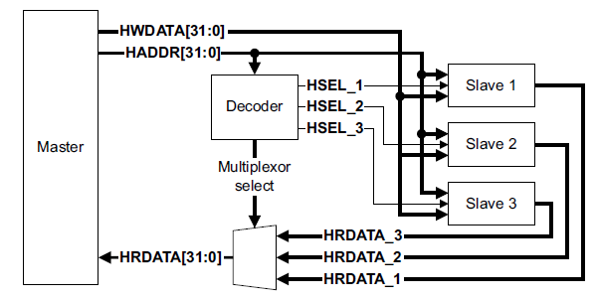
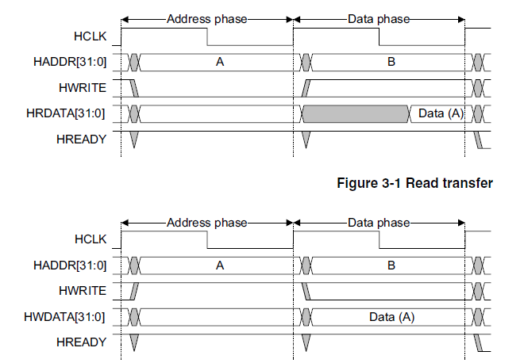
AHB Lite Transactions
Master Side:
- Basic Read
- Basic Write –
Burst Read – inc. burst lengths -1,4,8,16
- Burst Write – inc. burst lengths-1,4,8,16
Communication is initiated by master in our case using testbench.
Slave Side:
Can make the master wait
- Can give an Error Response
- But, slave can't terminate transaction; can ask master to insert wait state

Slide 8
Testbench Structure - Overview
Next few slides will describe the key sections of the testbench here.
Interface
Clocking Block
Clock & Reset Generation
Stimulus Generation
Response Checking

Slide 9
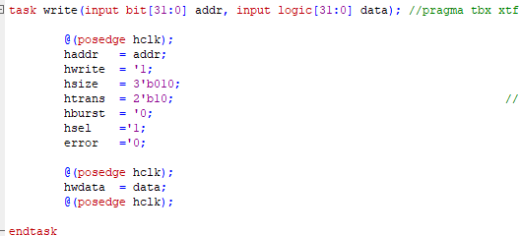
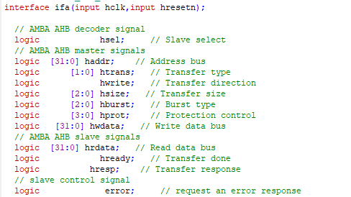
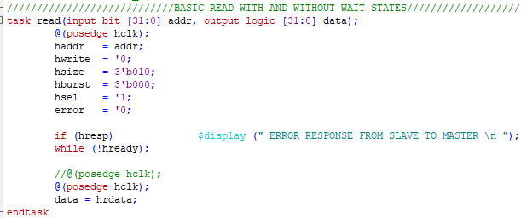
Testbench Structure - Interface

Slide 10

Testbench Structure - Clocking Block

Slide 11
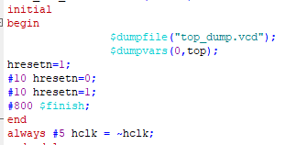
Testbench Structure – clock and reset generation

Slide 12
Testbench Structure - Stimulus Generation
Basic Read with or without wait states
Basic Write with or without wait sates
Read With Wait
Burst Read – inc. burst lengths -1,4,8,16
Burst Write – inc. burst lengths-1,4,8,16

Slide 13
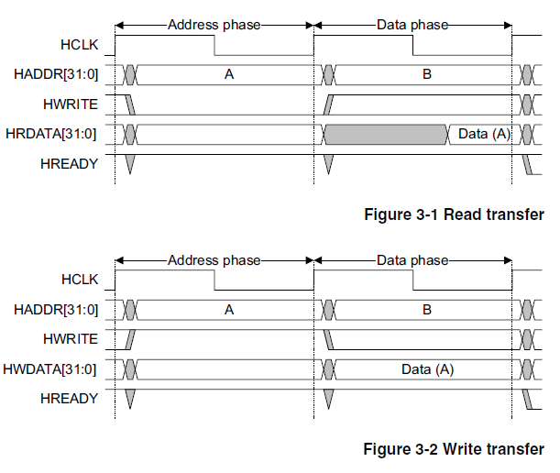
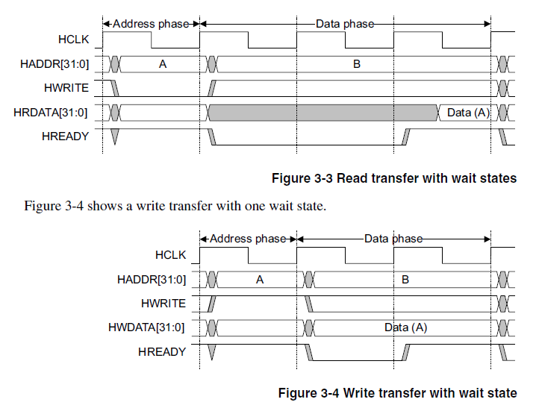
Testbench Structure - Stimulus Generation
Simple Read and Write Transfer Without wait state
Simple Read and Write Transfer With wait state

Slide 14
Testbench Structure - Stimulus Generation
no | Mode | Discription | stimulus
1 | hresetn | Read and Write at the specific address of the slave when hresetn is high. | hresetn=1
2 | hsel_0 | Write and Read from the specific address from slave when hsel is 0 | hsel=0
3 | basic_write_8bit | This is the basic write with data size 8bit on slave | apply reset turn clock on and toggles between 0 and 1 at some clock frequency. Apply hwrite=1, hsize=3'b000, hburst=3'b000,htrans= 2'b10, error=0, hsel=1, haddr=addr
4 | basic_read_8bit | This is the basic read on the slave with data size 8bit. | apply reset turn clock on and toggles between 0 and 1 at some clock frequency. Apply hwrite=0, hsize=3'b000, hburst=3'b000,htrans= 2'b10, error=0, hsel=1, haddr=addr
5 | basic_write_16bit | This is the basic write with data size 16bit on slave | apply reset turn clock on and toggles between 0 and 1 at some clock frequency. Apply hwrite=1, hsize=3'b001, hburst=3'b000,htrans= 2'b10, error=0, hsel=1, haddr=addr
6 | basic_read_16bit | This is the basic read on the slave with data size 16bit. | apply reset turn clock on and toggles between 0 and 1 at some clock frequency. Apply hwrite=0, hsize=3'b001, hburst=3'b000,htrans= 2'b10, error=0, hsel=1, haddr=addr

Slide 15
Testbench Structure - Stimulus Generation
` | Mode | Discription | stimulus
7 | basic_write_32bit | This is the basic write with data size 32bit on slave | apply reset turn clock on and toggles between 0 and 1 at some clock frequency. Apply hwrite=1, hsize=3'b010, hburst=3'b000,htrans= 2'b10, error=0, hsel=1, haddr=addr
8 | basic_read_32bit | This is the basic read on the slave with data size 32bit. | apply reset turn clock on and toggles between 0 and 1 at some clock frequency. Apply hwrite=0, hsize=3'b010, hburst=3'b000,htrans= 2'b10, error=0, hsel=1, haddr=addr
9 | basic_write_64bit | This is the basic write with data size 64bit on slave | apply reset turn clock on and toggles between 0 and 1 at some clock frequency. Apply hwrite=1, hsize=3'b011, hburst=3'b000,htrans= 2'b10, error=0, hsel=1, haddr=addr
10 | basic_read_64bit | This is the basic read on the slave with data size 64bit. | apply reset turn clock on and toggles between 0 and 1 at some clock frequency. Apply hwrite=0, hsize=3'b011, hburst=3'b000,htrans= 2'b10, error=0, hsel=1, haddr=addr
11 | basic_write_128bit | This is the basic write with data size 128bit on slave | apply reset turn clock on and toggles between 0 and 1 at some clock frequency. Apply hwrite=1, hsize=3'b100, hburst=3'b000,htrans= 2'b10, error=0, hsel=1, haddr=addr
12 | basic_read_128bit | This is the basic read on the slave with data size 128bit. | apply reset turn clock on and toggles between 0 and 1 at some clock frequency. Apply hwrite=0, hsize=3'b100, hburst=3'b000,htrans= 2'b10, error=0, hsel=1, haddr=addr

Slide 16
Testbench Structure - Stimulus Generation
no | Mode | Discription | stimulus
7 | basic_write_256bit | This is the basic write with data size 256bit on slave | apply reset turn clock on and toggles between 0 and 1 at some clock frequency. Apply hwrite=1, hsize=3'b101, hburst=3'b000,htrans= 2'b10, error=0, hsel=1, haddr=addr
8 | basic_read_256bit | This is the basic read on the slave with data size 256bit. | apply reset turn clock on and toggles between 0 and 1 at some clock frequency. Apply hwrite=0, hsize=3'b101, hburst=3'b000,htrans= 2'b10, error=0, hsel=1, haddr=addr
9 | basic_write_512bit | This is the basic write with data size 512bit on slave | apply reset turn clock on and toggles between 0 and 1 at some clock frequency. Apply hwrite=1, hsize=3'b110, hburst=3'b000,htrans= 2'b10, error=0, hsel=1, haddr=addr
10 | basic_read_512bit | This is the basic read on the slave with data size 512bit. | apply reset turn clock on and toggles between 0 and 1 at some clock frequency. Apply hwrite=0, hsize=3'b110, hburst=3'b000,htrans= 2'b10, error=0, hsel=1, haddr=addr
11 | basic_write_1024bit | This is the basic write with data size 1024bit on slave | apply reset turn clock on and toggles between 0 and 1 at some clock frequency. Apply hwrite=1, hsize=3'b111, hburst=3'b000,htrans= 2'b10, error=0, hsel=1, haddr=addr
12 | basic_read_1024bit | This is the basic read on the slave with data size 1024bit. | apply reset turn clock on and toggles between 0 and 1 at some clock frequency. Apply hwrite=0, hsize=3'b111, hburst=3'b000,htrans= 2'b10, error=0, hsel=1, haddr=addr

Slide 17
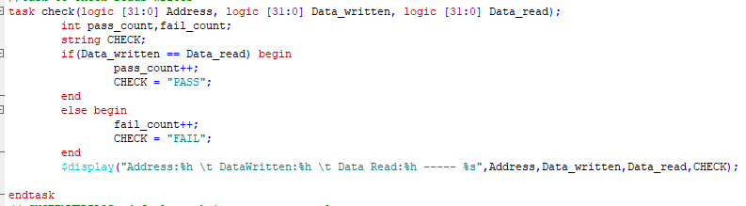
Testbench Structure - Response Checking
The task is created in the interface which compares the data written and data read. And tell, if the test is passed or not.

Slide 18
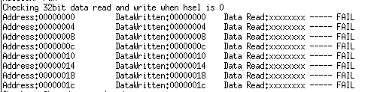
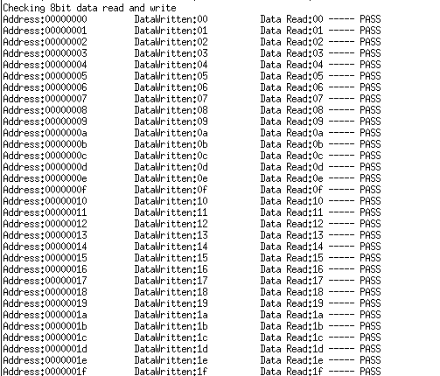
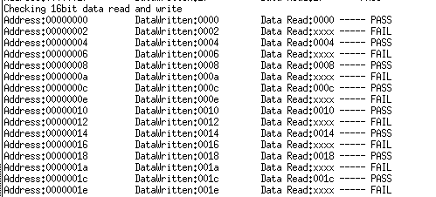
Testbench Structure - Response Checking

Slide 19
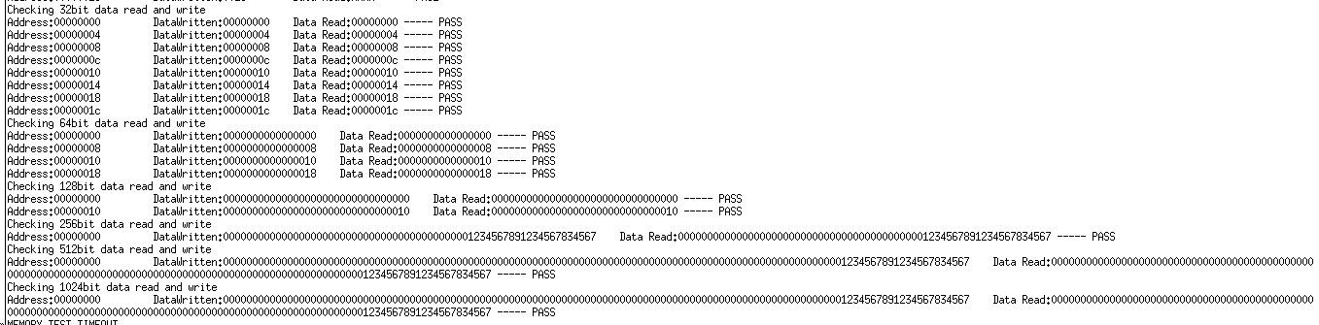
Testbench Structure - Response Checking

